Slide 1
Event Streaming Platform Kafka by Apache
Presented By:
GROUP 8
700741157 - Sai Sumanth Kolanupaka
700742907 - Sai Samhitha Mudigonda
700742905 - Mareedu Sai Sritha
700741284 - Renie Catherine Sathri
700742200 - Meghana Devidi

Slide 2
Contents
Overview
Uses of Kafka across industries
Core Capabilities of Kafka
Kafka Ecosystem
Architecture
Architecture Components
Kafka Commands
Uses and Alternatives of Kafka

Slide 3
Overview
Written in Scala and Open sourced By Apache, Kafka is distributed event streaming platform used by thousands of companies for data integration, building data pipelines, and analysis over streaming data.

Slide 4
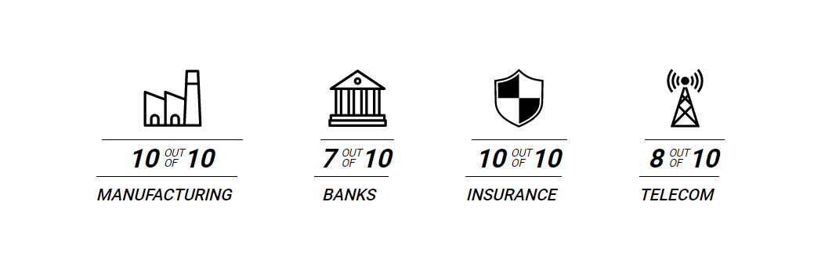
Uses of Kafka across industries

Slide 5
Core Capabilities of Kafka
High Throughput
Scalable
Permanent storage
Distributed
Fault tolerant
High Availabilty

Slide 6
Kafka Ecosystem
Built-In stream processing:-
Kafka processes streams of events without any failure and exactly once.
It can also join, aggregates, filters and transform data
Connect to Almost anything:-
Kafka connect interface let it to connect with thousands of event sources and event sink like MongoDB, Postgres, AWS S3 etc.

Slide 7
Kafka Ecosystem Contd.
Vast client libraries:-
Kafka can process stream of events along with read and write in
Multiple programming languages like Python, Scala and Java.
Large Ecosystem Open Source tools:-
It has a community driven with like minded pool of people to serve large ecosystem of open source tools.

Slide 8
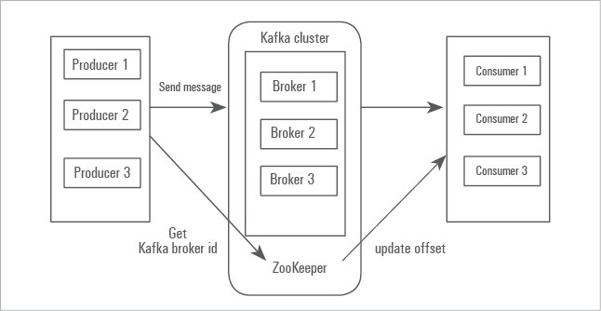
Architecture Diagram

Slide 9
Architecture Components
There are mainly 4 components in Kafka architecture
Producer
Consumer
Kafka Broker
Zookeeper

Slide 10
The Producer/Publisher
A producer is responsible for publishing or writing data to the topics within different partitions.
Producers automatically know that, what data should be written to which partition and broker.

Slide 11
The Consumer/Subscriber
A Consumer is an application that reads data in an incremental and ordered fashion from different Kafka Topics.
It can subscribe to one or more topics in the Kafka cluster and consumes messages from them.

Slide 12
Kafka Broker
A broker is the central component of Kafka architecture.
Multiple brokers combine together to form a Kafka Cluster.
Producers and consumers communicate with brokers in order to publish and consume messages.

Slide 13
Zookeeper
Kafka depends on an underlying technology called Zookeeper.
Zookeeper is a generalized cluster management tool. It manages the cluster and provides a consistent, distributed place to store cluster configuration.
Zookeeper coordinates communication throughout the cluster adds and removes brokers, and monitors the status of nodes in the cluster

Slide 14
Kafka CLI Commands
Starting Zookeeper server:-
kafka/bin/zookeeper-server-start.bat \
kafka/config/zookeeper.properties
Creating Kafka Topic:-
bin/kafka-topics.bat –create –bootstrap-server localhost:9092 –replication-factor 5 –partitions 5 –topic vowels

Slide 15
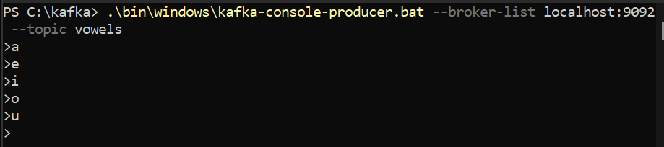
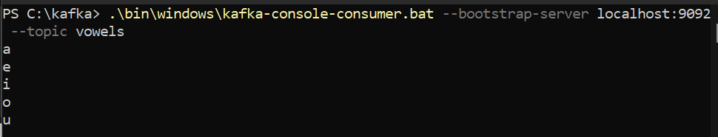
Kafka CLI commands contd.
Kafka Producer CLI command:-
kafka-console-producer.bat --topic vowels --bootstrap-server localhost:9092
Kafka Consumer CLI command:-
kafka-console-consumer.bat --bootstrap-server localhost:9092 --topic vowels –from-beginning

Slide 16
Uses and Alternatives to Kafka
Real Time Use Case of Kafka:-
Processing Data in Real-Time
IoT Data Analysis
Centralize Raw Logs Data
A Distributable Streaming Platform
Alternatives to Kafka:-
Amazon Kinesis
RabbitMQ
ActiveMQ

